Slide 1
Python Course for Physicists (And everyone else!) Chunk 1: Introduction & Setup
By Jonathan Bollig
08.10.2025

Slide 2

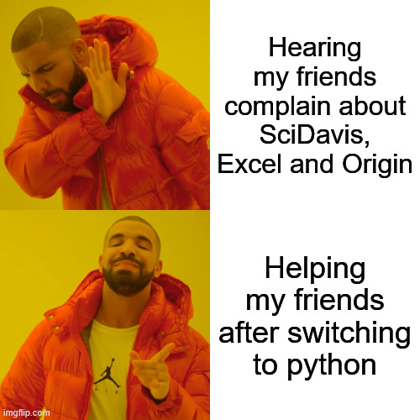
Background & About Me
jonathan.bollig@uni-jena.de
Master: Physics & Photonics
Bachelor: Physics in Jena
Self-taught Python with YouTube before studying
Super useful in physics
Tried to convince all my friends
Now a course for everyone else
→ First time, let’s see how it goes ☺
Notes:
Go with the flow
Vielleicht erwähnen, dass ich nicht bezahlt werde?

Slide 3


The Tutors
Erik Prenzel (erik.prenzel@uni-jena.de)
Student in Physics Master
Friend of Jonathan
Learned Python during my studies, 100% worth it
Hinrich Dirksen (hinrich.dirksen@uni-jena.de)
Currently pursuing my experimental physics master thesis
I use Python everyday from data analysis+vis. to small simulations and automations in the lab
3x better code since GitHub copilot arrived

Slide 4


The Tutors
Philipp Janzen (philipp.janzen@uni-jena.de)
Physics Master‘s student
Friend of Jonathan
Learned Python during my studies
Verena Menhofer (verena.menhofer@uni-jena.de)
Physics Master‘s student
Another friend of Jonathan
Started learning Python with YouTube, but mostly learnt as needed during studies

Slide 5
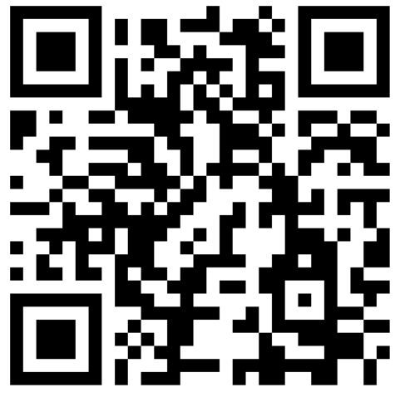
About You: (Experimental) Questionare
https://vibes.fh-muenster.de/apps/live-votings/XETR2/
Notes:
Only in German, but we will manage

Slide 6
General Information – Times and Dates
Dates:
Wednesday (08.10) to Friday (10.10)
Times:
Start at 09:30
Lunchbreak 12:00 – 13:00
Finish: ~16:30
Lecturing type:
~20-minute lectures (Chunks) with ~50-minute practice sessions
2 chunks before and 3 after lunch (Friday afternoon tbd.)

Slide 7
General Information – Lecturing Type
20 Minute Lectures: Concise introductions to topics
YouTube tutorial style (Presentation + Live Coding)
PDFs are uploaded
50 Minute self practice:
Usage of Jupyter Notebooks: Tasks and solutions in one place.
Core Tasks, Optional Tasks & Advanced Topics / Tasks
Generally:
Come and Go whenever you like
Ask Questions directly (Maybe everyone is wondering the same)
ALL Slides etc. are shared ☺

Slide 8

Why Coding?
Data Analysis
Visualization
Simulations
Automation
Machine Learning
…

Slide 9
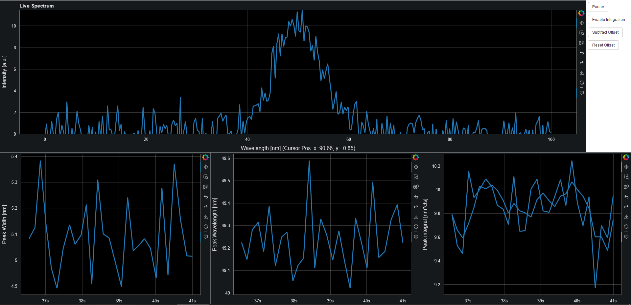
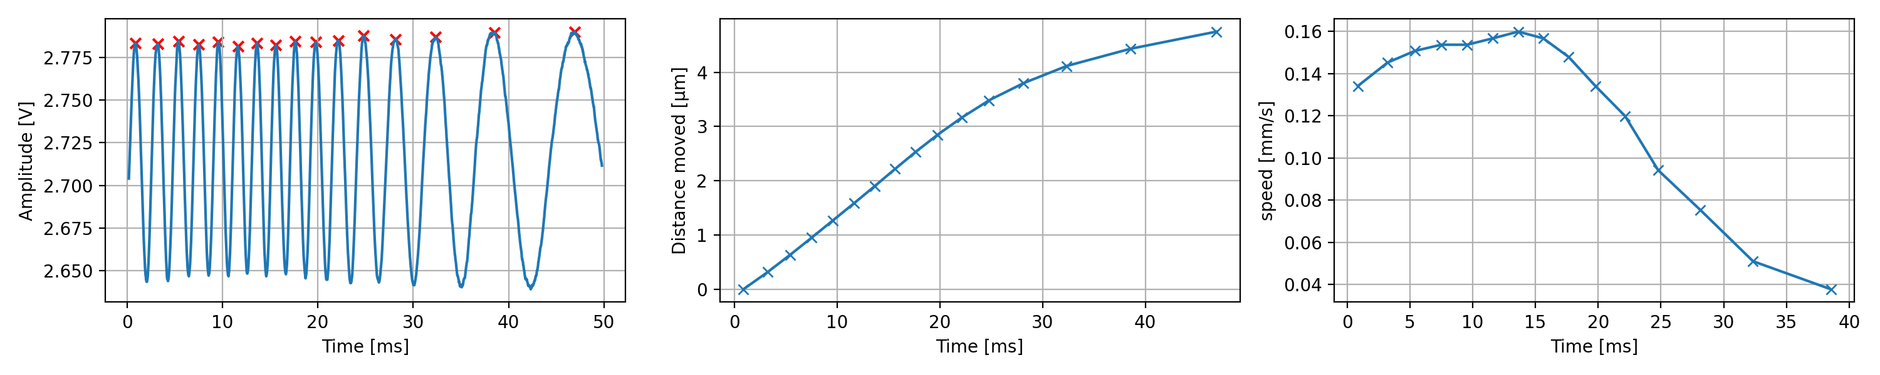
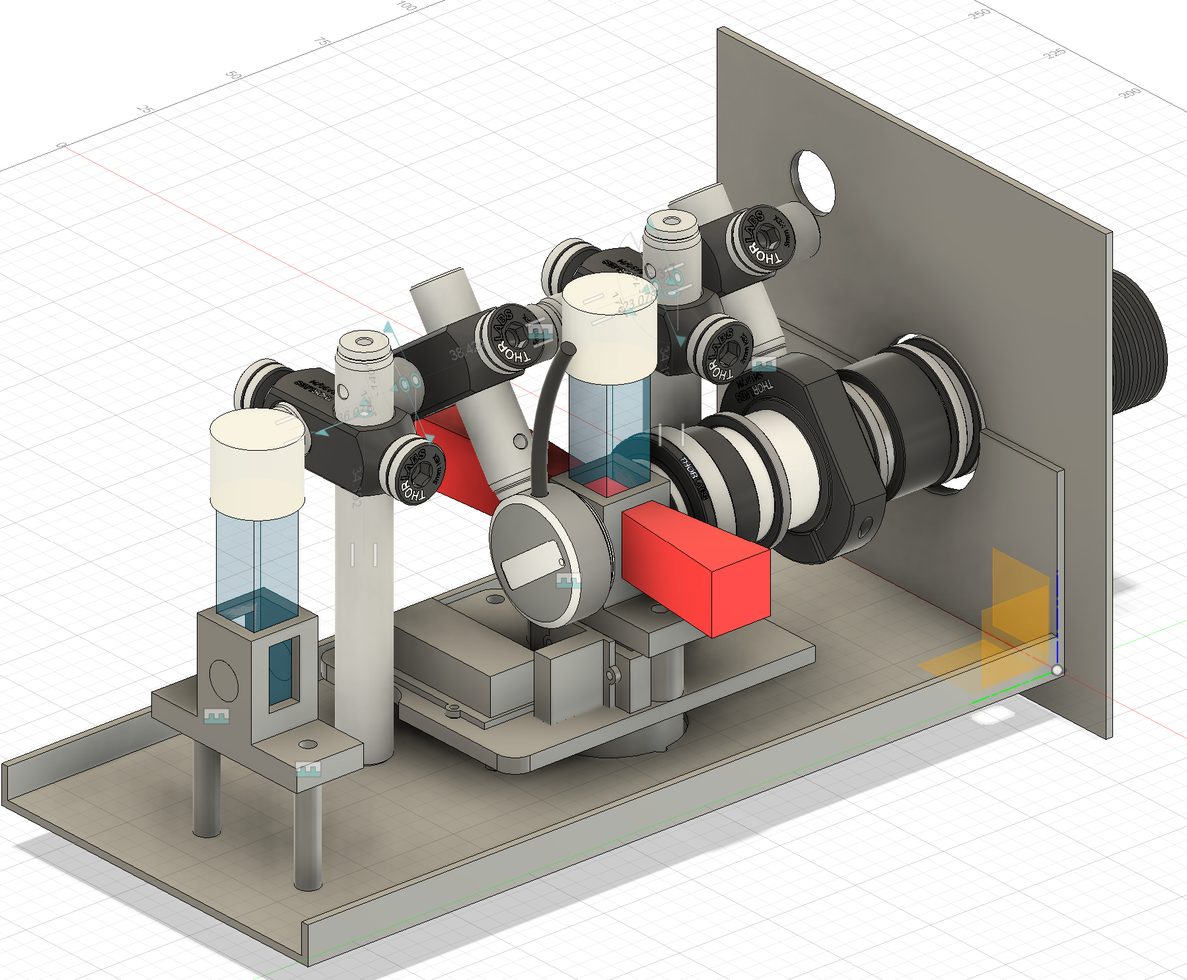
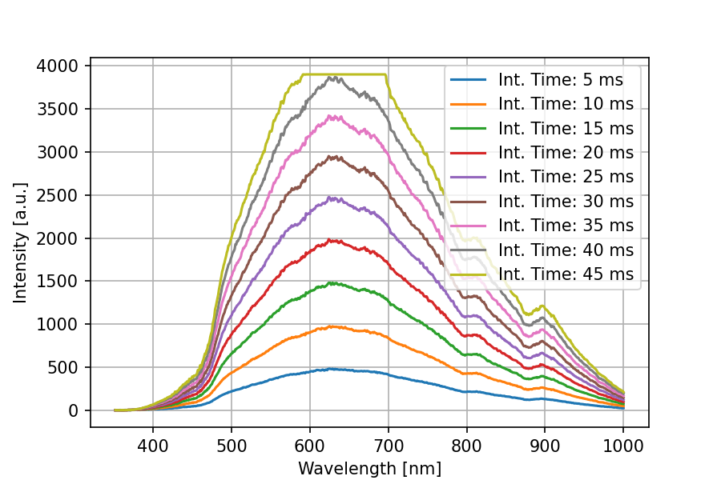
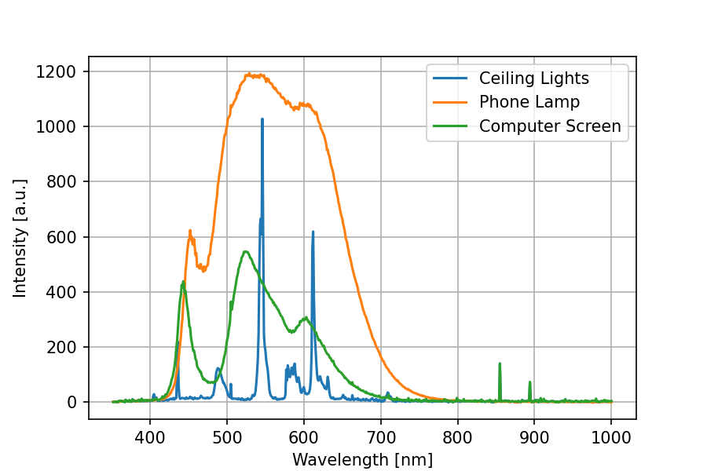
Own Examples
Spectrometer Software
Automated Experiment
Lab Data Analysis

Slide 10
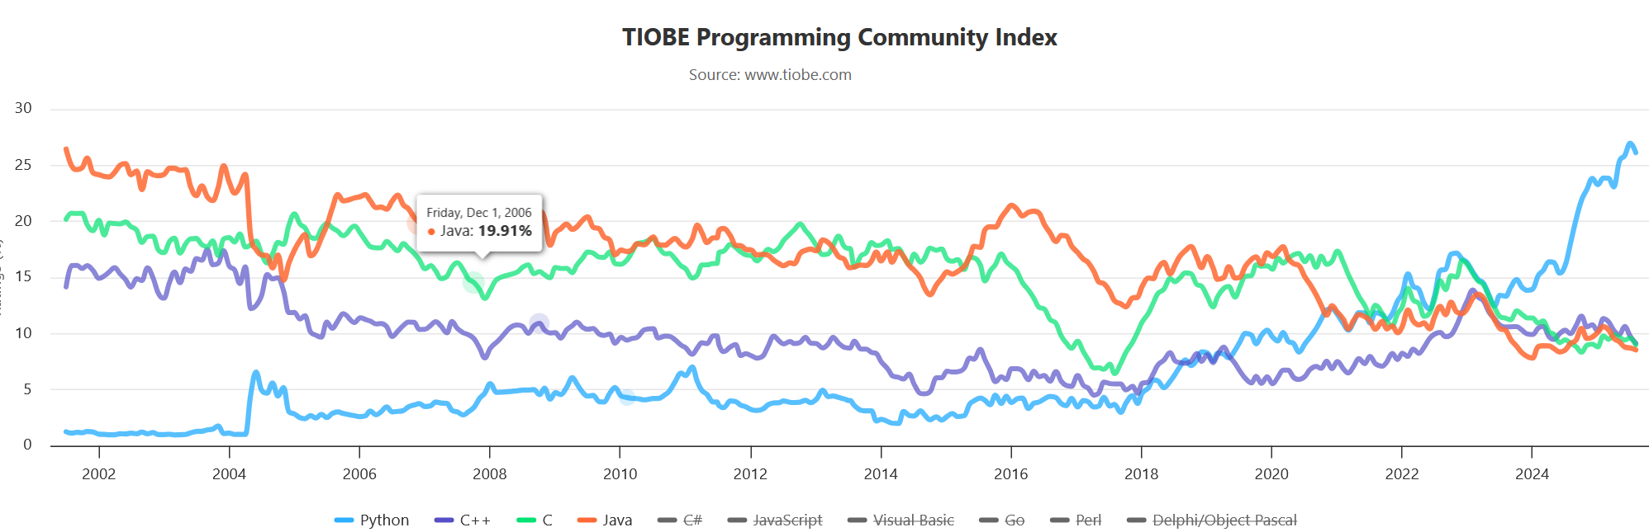
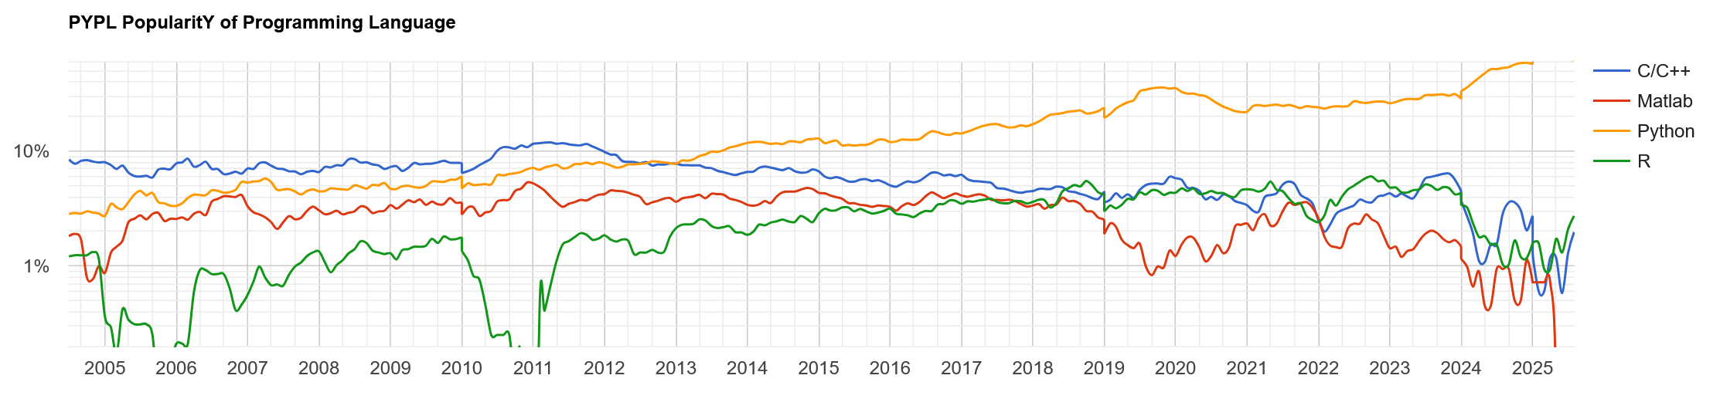
Why Python?
Most popular programming language world-wide
Web Development, AI / LLM, Data Science
Popular in the scientific community (anecdotal evidence)
Open Source / Free
Easy to learn
[https://pypl.github.io/PYPL.html]
[https://www.tiobe.com/tiobe-index/]
Notes:
Tiobe Index: Complicated calculation
Pypl Index: Popularity based on web searches (Here Data for Germany)
Anecdote on Python helping me in applications

Slide 11
Learning goals
Ability to use python as a tool in everyday (physics) life
Read and write data
Process and clean data
Visualize data
We won’t cover
Game Design
Webdesign
What I might cover in the future:
Recursion
Version Control w. Git
Pretty Coding / PEP / Typing
Object Oriented Programming
Multithreading / Processing
40 Lines of Code
All understandable by you (in 2 days)

Slide 12
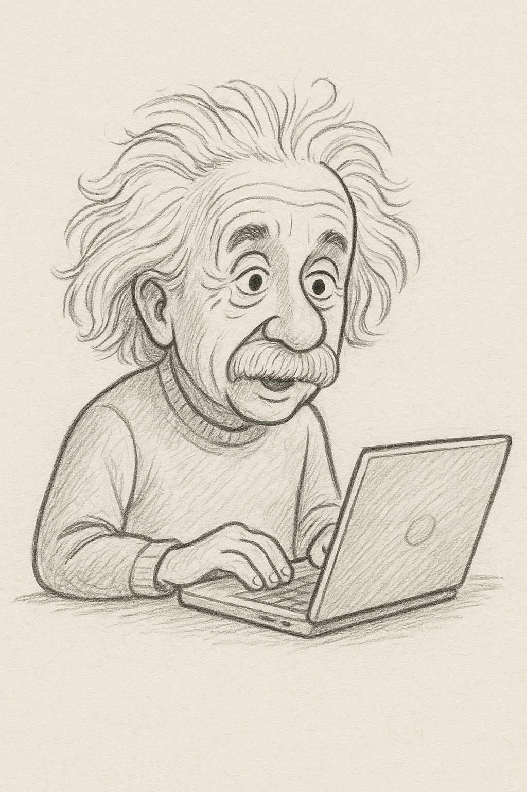
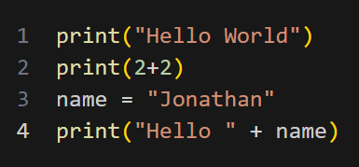
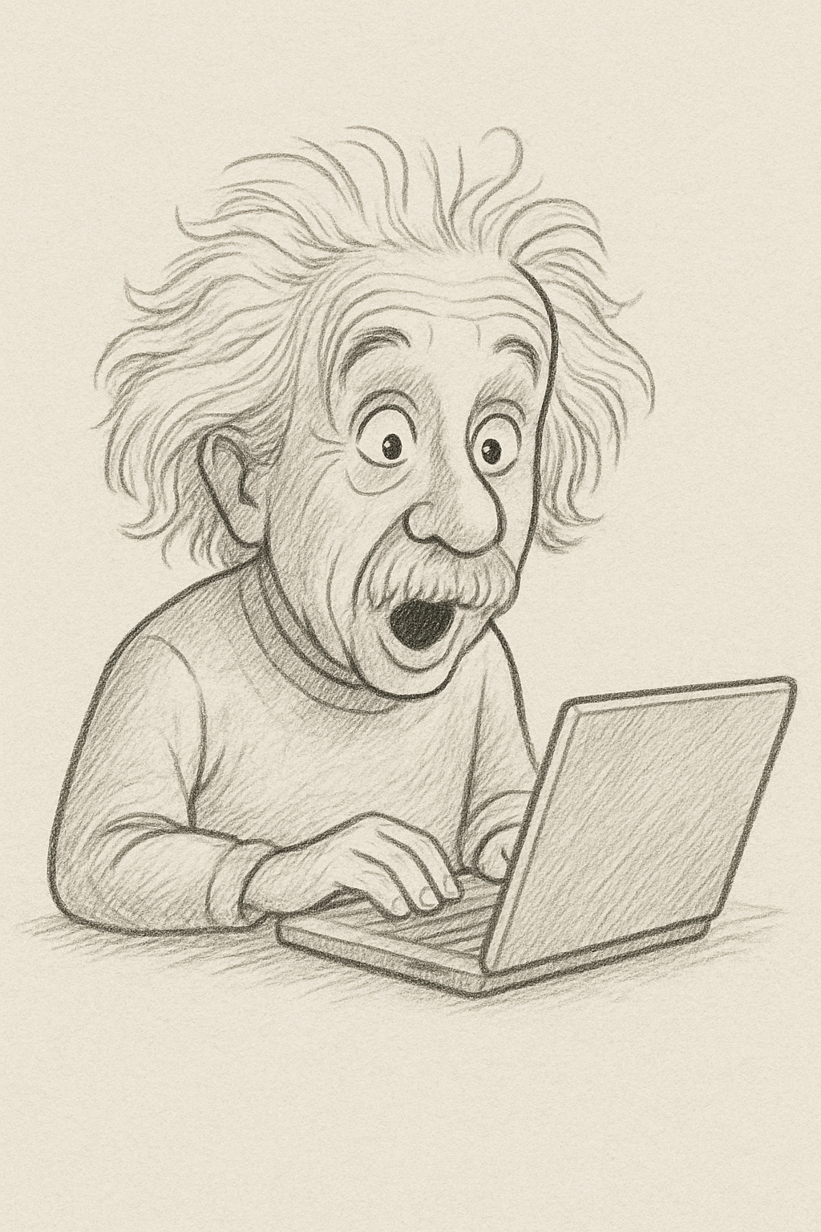
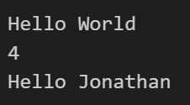
What is a program?
Some Magic 🪄
(Beyond our scope, google if interested)
[ChatGPT ☺]
[ChatGPT ☺]

Slide 13
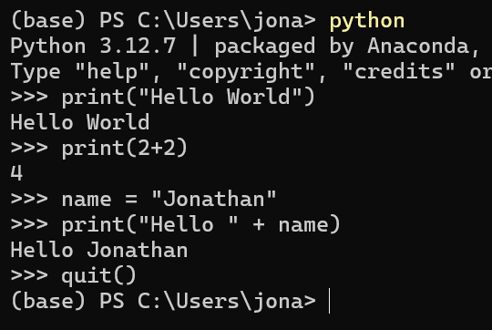
2,5 Ways of Coding in Python
Skript:
Starts Python
Runs Code from first to last line
Finishes (closes Python) when last line is executed
After execution: Memory lost
Interactive:
Python is started
Executes commands “on the go”
Python is manually closed
→ Memory maintained

Slide 14
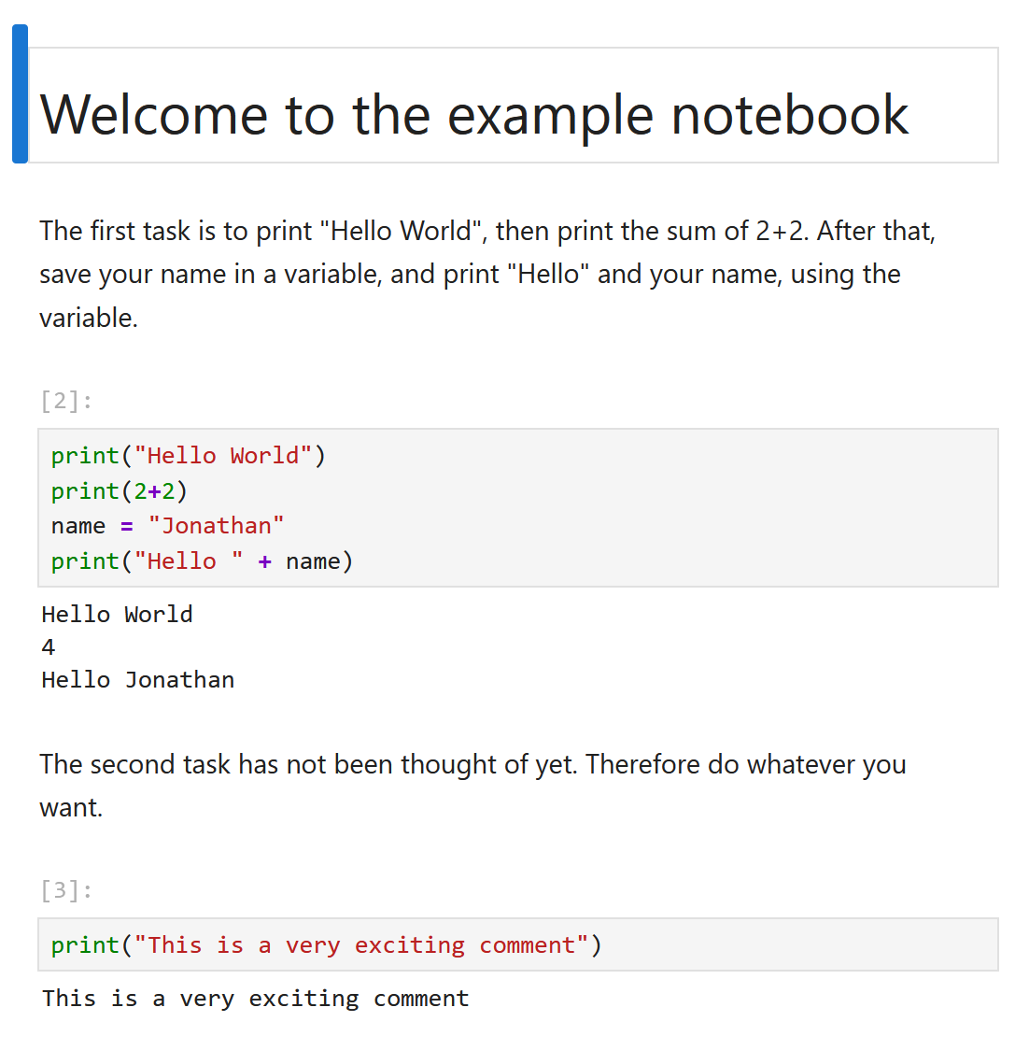
2,5 Ways of Coding in Python: Notebooks
Jupyter Notebooks are interactive, but group code in cells:
Advantages:
Tasks, Cheat Sheets and place for solving all in one place.
No extra IDE needed.
Disadvantages:
Sometimes stuff works, that shouldn’t
Can promote bad coding practises
In this course: Python + Notebooks treated as one. At end of course: Introduction to other IDEs (maybe)

Slide 15
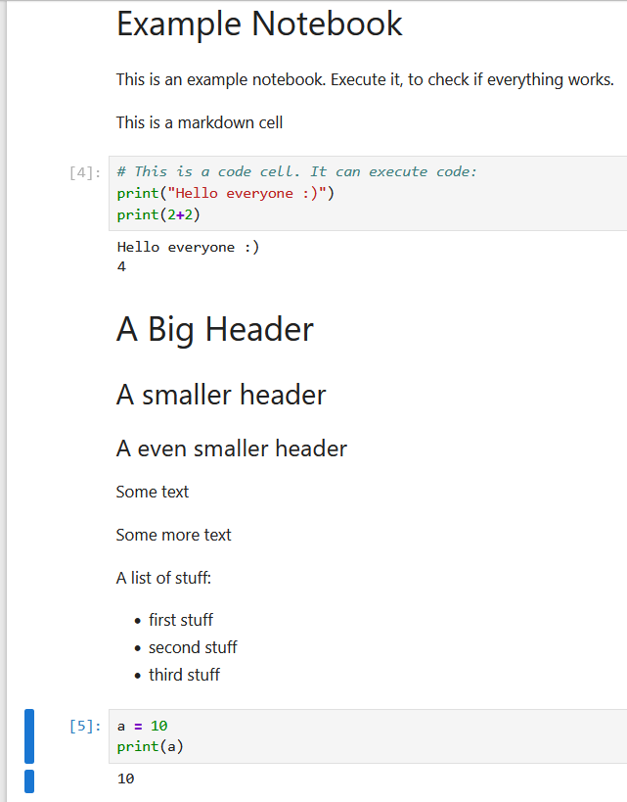
Notebook Live Demo: Cells
Markdown Cells
Code Cells
Cells can be:
Moved
Copy Pasted
Etc.

Slide 16
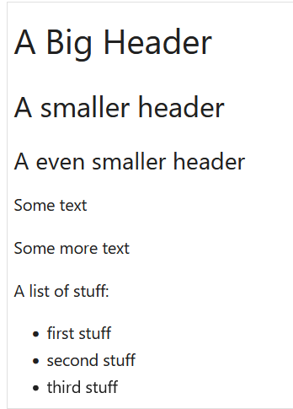
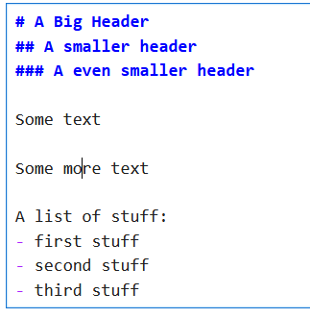

Notebook Live Demo: Markdown Cells
Execute Cell: Shift + Enter or

Slide 17

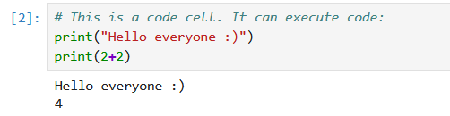
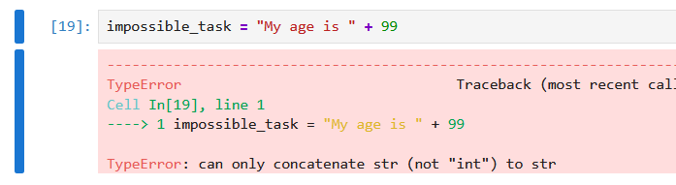
Notebook Live Demo: Code Cells
Number indicates execution
Errors appear in Red
Pay attention to last line
Execute Cell: Shift + Enter or

Slide 18

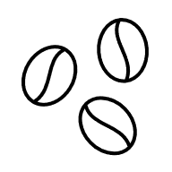
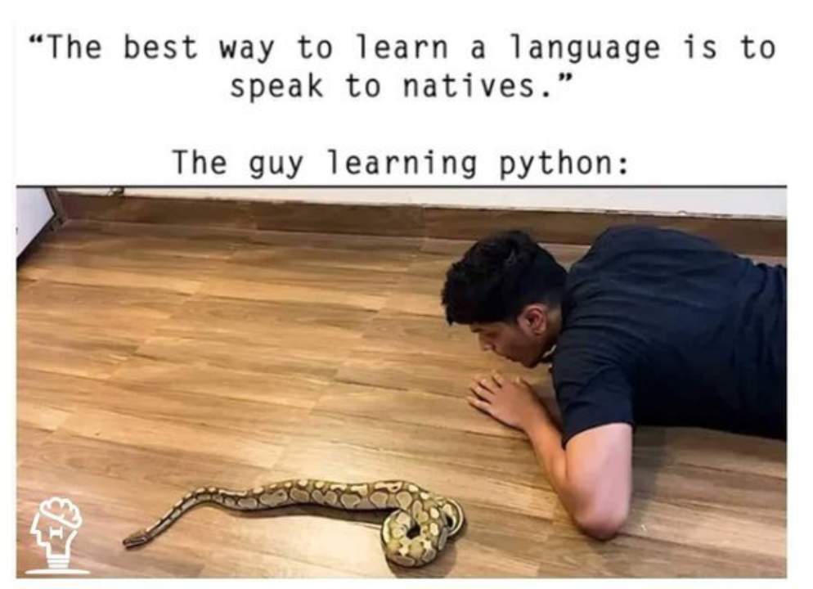
Now you:
Try to open the file “Tasks_1_2_example_notebook.ipynb” and execute the cells
In case of problems: Ask us
Time: 20 Minutes (inkl. Coffee Break)
[https://dev.to/codeitbro/15-funniest-and-hilarious-python-coding-memes-2aij]

